Slide 1


Accelerating MLOps with Vertex AI
Unifying the Machine Learning Lifecycle from Data to Production
Presented by: GCP AI Strategy & Engineering

Slide 2

Solving the "Production Gap"
The Challenge
80%
Most ML models fail to reach production due to operational decay and technical debt. Data scientists spend the majority of their time managing infrastructure rather than refining models.
"Plumbing" Overhead
Manual Friction: Hand-crafted handovers cause silos.
The Solution: Bridging CI/CD and DevOps with ML.

Slide 3






Vertex AI: The Unified Platform
Data Readiness
Model Development
Model Operations
Managed datasets and feature engineering with deep BigQuery integration.
Serverless training environment supporting TF, PyTorch, and XGBoost.
Enterprise-grade deployment, monitoring, and lifecycle governance.
Unified API Interface for the Entire ML Lifecycle

Slide 4



Vertex AI Feature Store
Solving Training-Serving Skew: Ensure consistent feature definitions across batch training and real-time inference.
Offline Serving
High-throughput feature extraction for model training.
Online Serving
Low-latency lookup for real-time predictions.

Slide 5

Vertex AI Pipelines & Training
Serverless Training: BYOC (Bring Your Own Container) support. Fully managed scaling with GPU/TPU acceleration.
Kubeflow-Based Pipelines: Automate ML workflows via DAGs. Ensure absolute reproducibility of experiments.

Slide 6


Vertex AI Model Registry
Single Source of Truth
Lifecycle Aliases
Stop searching GCS buckets. The Registry provides a unified warehouse for all trained model versions and their lineage.
Use labels like "Production", "Staging", or "Canary" to shift traffic without changing endpoint code.
Integrated Model Versioning & Rollback Strategies

Slide 7
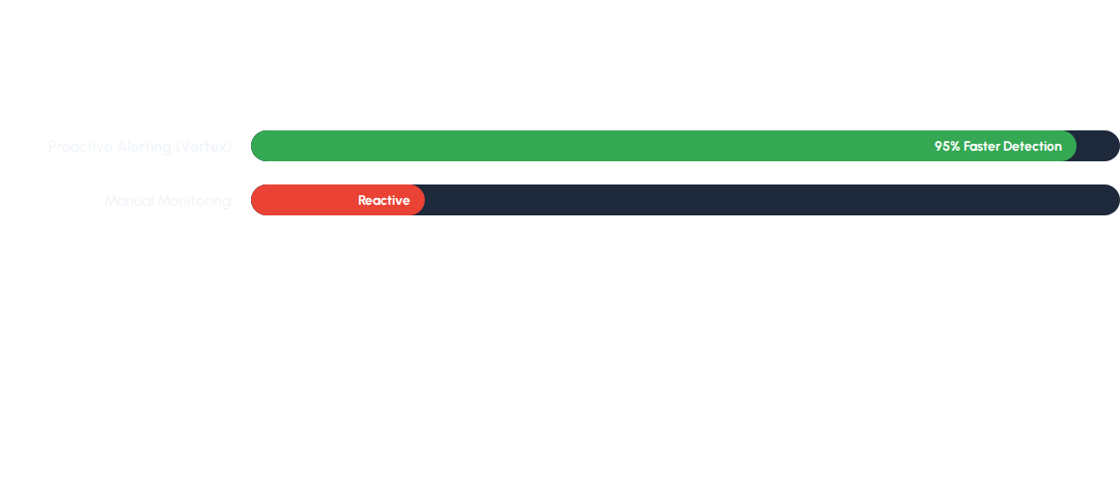
Continuous Model Monitoring
Drift Detection: Automated alerts when live traffic deviates from the training baseline.
Feature Attribution: Explainable AI identifies exactly which feature is causing performance drops.

Slide 8
The "Happy Path" Workflow
1. Data: Extract from BQ/Cloud Storage.
2. Feature Store: Registry & Serving.
3. Pipeline: Orchestrate Training.
4. Registry: Versioned Storage.
5. Endpoint: Deploy at Scale.
6. Monitoring: Active Feedback Loop.

Slide 9
Key Takeaways
Reduced Overhead: Managed infrastructure.
Reliability: Reproducible KFP Pipelines.
Control: Monitoring & Registry governance.
Data Integrity: Centralized Feature Store.
Any Questions?
Contact your GCP Solutions Team for a Deep Dive

Slide 10




Image Sources
https://cdn-contents.anymindgroup.com/corporate/wp-uploads/2023/01/30090619/deployment_pipeline.png
Source: anymindgroup.com
https://dagshub.com/blog/content/images/2021/08/DAG2.png
Source: dagshub.com
https://cdn.prod.website-files.com/6130fa1501794e37c21867cf/6605cfe2ce555dc151633669_AD_4nXfSe5HK16tpgaOewApnzSM4N6ou004cVhHOGegULdEG1pu5erYD827sTZ5j6Tpv-QAi5ql1-0APp1aQpekKF86eGxfx-wdm8Vzv_u-y0m_LFXJvELTsE6-2PVujpfRt_ejI5kYMDwe-3m6huyCnzVM.png
Source: www.fivetran.com
https://storage.googleapis.com/gweb-cloudblog-publish/images/whts_new_2025_5V6FQkI.max-2500x2500.jpg
Source: cloud.google.com

